Slide 1
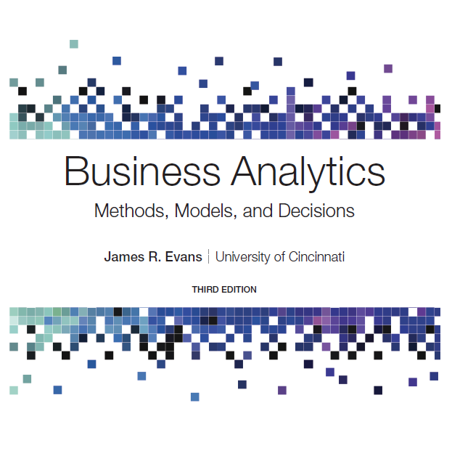
Business Analytics: Methods, Models, and Decisions
Third Edition
Chapter 15
Optimization Analytics
Copyright © 2020, 2016, 2013 Pearson Education, Inc. All Rights Reserved
Notes:
If this PowerPoint presentation contains mathematical equations, you may need to check that your computer has the following installed:
1) MathType Plugin
2) Math Player (free versions available)
3) NVDA Reader (free versions available)

Slide 2
What-If Analysis for Optimization Models
Models should be used to provide insight for making better decisions.
What might happen should the model assumptions change or when the data used in the model are uncertain?
With Solver, answers to such questions can easily be found by simply changing the data and re-solving the model.

Slide 3
Example 15.1: Using Solver for What-If Analysis (1 of 2)
Four questions are posed by the managers of Sklenka Ski company:
If the Jordanelle ski’s profit increased $10/pair, how would the optimal solution change?
If the Jordanelle ski’s profit decreased $10/pair, how would the optimal solution change?
If 10 additional finishing hours were available, how would manufacturing plans be affected?
If 2 fewer finishing hours were available, how would manufacturing plans be affected?

Slide 4
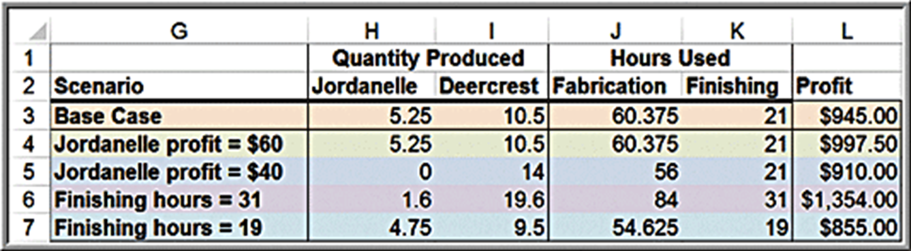
Example 15.1: Using Solver for What-If Analysis (2 of 2)
Summary of What-If scenarios:

Slide 5
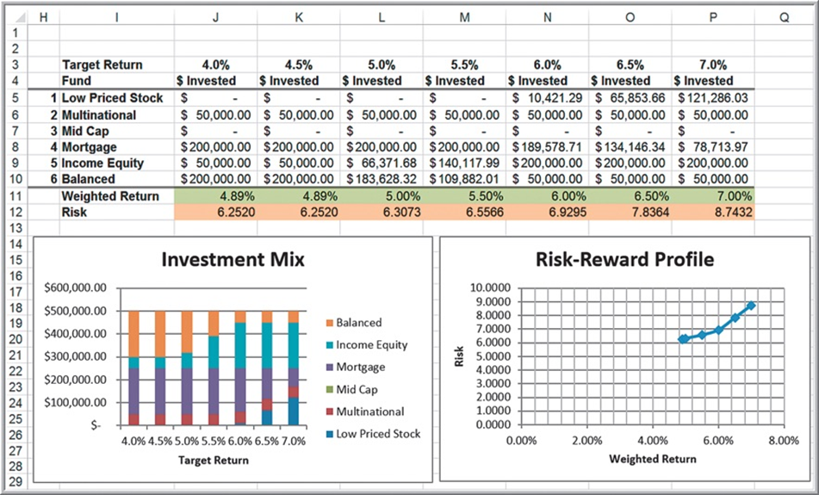
Example 15.2: Evaluating Risk Versus Reward in Portfolio Management
Innis Investments (Example 13.16)
Compare how the return, risk, and investment mix would change for different values of the target return.

Slide 6
Solver Sensitivity Report
The Sensitivity Report allows us to understand how
the optimal objective value and optimal decision variables are affected by changes in the objective function coefficients,
the impact of forced changes in certain decision variables, or
the impact of changes in the constraint resource limitations or requirements.
Caution: The Sensitivity Report information applies to changes in only one of the model parameters at a time; all others are assumed to remain at their original values.

Slide 7
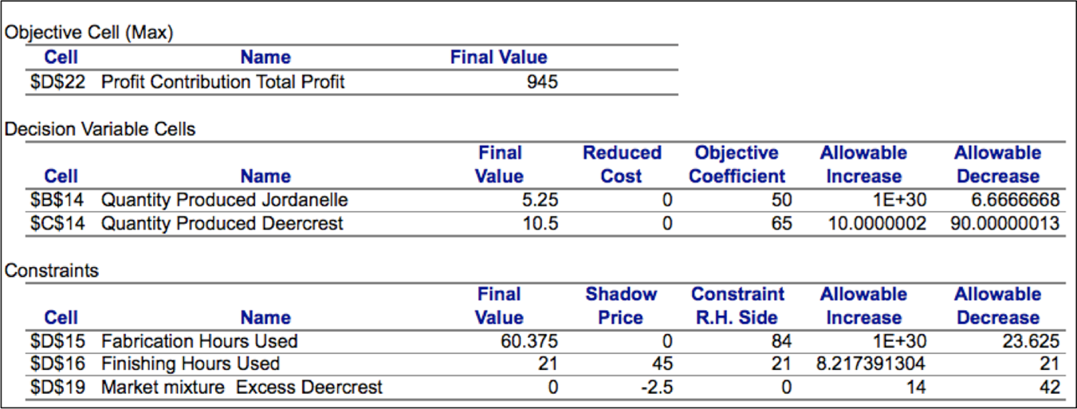
Sensitivity Report for the S S C Problem

Slide 8
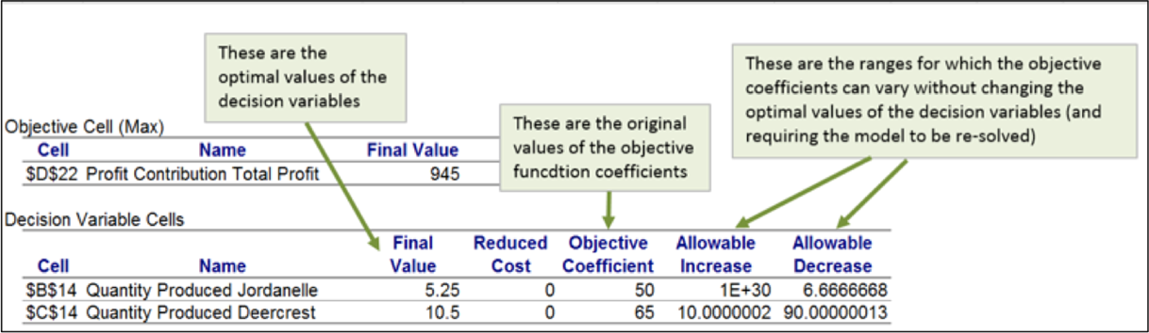
Example 15.3: Interpreting Sensitivity Information for Decision Variables
Reduced Cost: How much the objective function coefficient needs to be reduced for a nonnegative variable that is zero in the optimal solution to become positive. If a variable is positive in the optimal solution, its reduced cost is zero.
If the objective coefficient of any one variable that has positive value in the current solution changes but stays within the range specified by the Allowable Increase and Allowable Decrease, the optimal decision variables will stay the same; however, the objective function value will change.

Slide 9
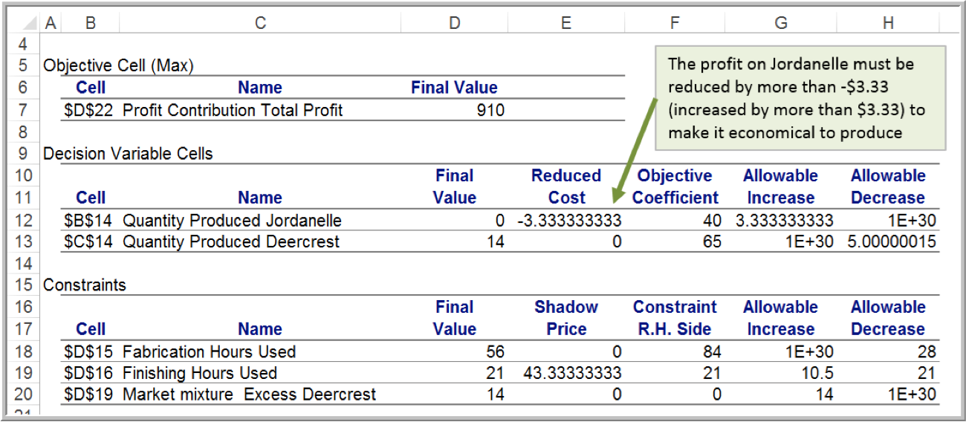
Example 15.4: Understanding Nonzero Reduced Costs
Sensitivity report for the Sklenka Ski model after changing the profit on Jordanelle skis from $50 to $40

Slide 10
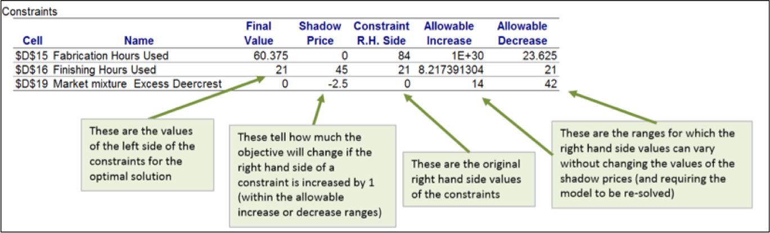
Example 15.5: Interpreting Sensitivity Information for Constraints
Shadow Price - how much the objective function will change as the right hand side of a constraint is increased by 1.
Whenever a constraint has positive slack, the shadow price is zero. When a constraint involves a limited resource, the shadow price represents the economic value of having an additional unit of that resource.

Slide 11
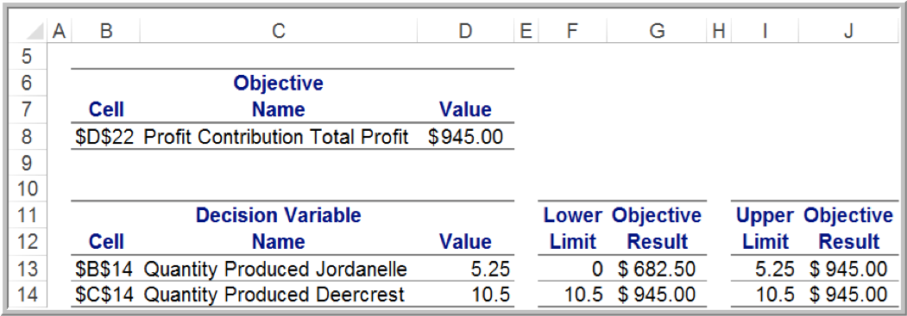
Limits Report
Shows the upper and lower limits that each decision variable can assume while satisfying all constraints and holding the other variables constant.

Slide 12
Using the Sensitivity Report (1 of 2)
If a change in an objective function coefficient remains within the Allowable Increase and Allowable Decrease ranges in the Decision Variable Cells section of the report, then the optimal values of the decision variables will not change. However, you must recalculate the value of the objective function using the new value of the coefficient.
If a change in an objective function coefficient exceeds the Allowable Increase or Allowable Decrease limits in the Decision Variable Cells section of the report, then you must re-solve the model to find the new optimal values.

Slide 13
Using the Sensitivity Report (2 of 2)
If a change in the right-hand side of a constraint remains within the Allowable Increase and Allowable Decrease ranges in the Constraints section of the report, then the shadow price allows you to predict how the objective function value will change. Multiply the change in the right-hand side (positive if an increase, negative if a decrease) by the value of the shadow price. However, you must re-solve the model to find the new values of the decision variables.
If a change in the right-hand side of a constraint exceeds the Allowable Increase or Allowable Decrease limits in the Constraints section of the report, then you cannot predict how the objective function value will change using the shadow price. You must re-solve the problem to find the new solution.

Slide 14
Example 15.6: Using Sensitivity Information to Evaluate Scenarios (1 of 4)
Suppose that the unit profit on Jordanelle skis is increased by $10. How will the optimal solution change? What is the best product mix?
Decision Variable Cells
Cell | Name | Final Value | Reduced Cost | Objective Coefficient | Allowable Increase | Allowable Decrease
$B$14 | Quantity Produced Jordanelle | 5.25 | 0 | 50 | 1E+30 | 6.6666668
$C$14 | Quantity Produced Deercrest | 10.5 | 0 | 65 | 10.0000002 | 90.00000013
Is the increase in the objective function coefficient within the range of the Allowable Increase and Allowable Decrease in the Decision Variable Cells portion of the report?
Because $10 is less than the Allowable Increase of infinity, we can safely conclude that the optimal quantities of the decision variables will not change.
However, because the objective function changed, we need to compute
the new value of the total profit:

Slide 15
Example 15.6: Using Sensitivity Information to Evaluate Scenarios (2 of 4)
Suppose that the unit profit on Jordanelle skis is decreased by $10 because of higher material costs. How will the optimal solution change? What is the best product mix?
Decision Variable Cells
Cell | Name | Final Value | Reduced Cost | Objective Coefficient | Allowable Increase | Allowable Decrease
$B$14 | Quantity Produced Jordanelle | 5.25 | 0 | 50 | 1E+30 | 6.6666668
$C$14 | Quantity Produced Deercrest | 10.5 | 0 | 65 | 10.0000002 | 90.00000013
The change in the unit profit exceeds the Allowable Decrease ($6.67). We can conclude that the optimal values of the decision variables will change, although we must re-solve the problem to determine what the new values would be.

Slide 16
Example 15.6: Using Sensitivity Information to Evaluate Scenarios (3 of 4)
Suppose that 10 additional finishing hours become available through overtime. How will manufacturing plans be affected?
Constraints
Cell | Name | Final Value | Shadow Price | Constraint R.H. Side | Allowable Increase | Allowable Decrease
$D$15 | Fabrication Hours Used | 60.375 | 0 | 84 | 1E+30 | 23.625
$D$16 | Finishing Hours Used | 21 | 45 | 21 | 8.217391304 | 21
$D$19 | Market mixture Excess Deercrest | 0 | −2.5 | 0 | 14 | 42
Check if the change in the right-hand-side value is within the range of the Allowable Increase and Allowable Decrease in the Constraints section of the report.
Ten additional finishing hours exceeds the Allowable Increase. Therefore, we must re-solve the problem to determine the new solution.

Slide 17
Example 15.6: Using Sensitivity Information to Evaluate Scenarios (4 of 4)
What if the number of finishing hours available is decreased by 2 hours because of planned equipment maintenance? How will manufacturing plans be affected?
Constraints
Cell | Name | Final Value | Shadow Price | Constraint R.H. Side | Allowable Increase | Allowable Decrease
$D$15 | Fabrication Hours Used | 60.375 | 0 | 84 | 1E+30 | 23.625
$D$16 | Finishing Hours Used | 21 | 45 | 21 | 8.217391304 | 21
$D$19 | Market mixture Excess Deercrest | 0 | −2.5 | 0 | 14 | 42
A decrease of 2 hours in finishing capacity is within the Allowable Decrease. Total profit will decrease by the value of the shadow price for each hour that finishing capacity is decreased. Therefore,
we can predict that the total profit will decrease by
to $855. However, we must re-solve the model in order to determine the new values of the decision variables.

Slide 18
Degeneracy
A solution is a degenerate solution if the right-hand-side value of any constraint has a zero Allowable Increase or Allowable Decrease.
Degeneracy can impact the interpretation of sensitivity analysis information. For example, reduced costs and shadow prices may not be unique, and you may have to change objective function coefficients beyond their allowable increases or decreases before the optimal solution will change.

Slide 19
Interpreting Solver Reports for Nonlinear Optimization Models
Solver provides Answer, Sensitivity, and Limits reports for nonlinear optimization models.
However, the Sensitivity report is quite different from that for linear models.

Slide 20
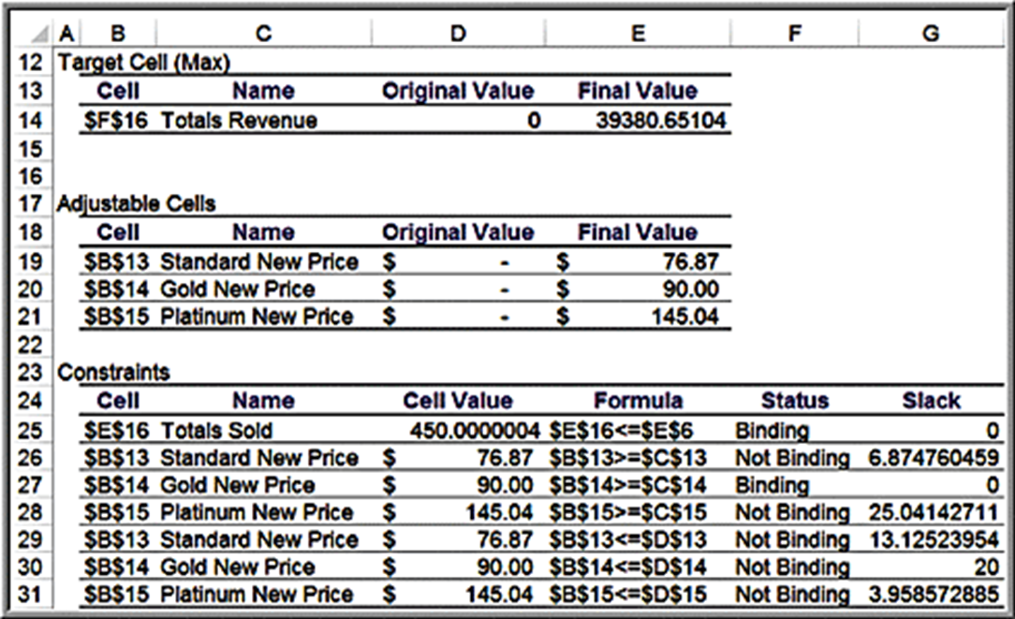
Example 15.7: Interpreting Solver Reports for the Hotel Pricing Model (1 of 2)
Answer Report

Slide 21
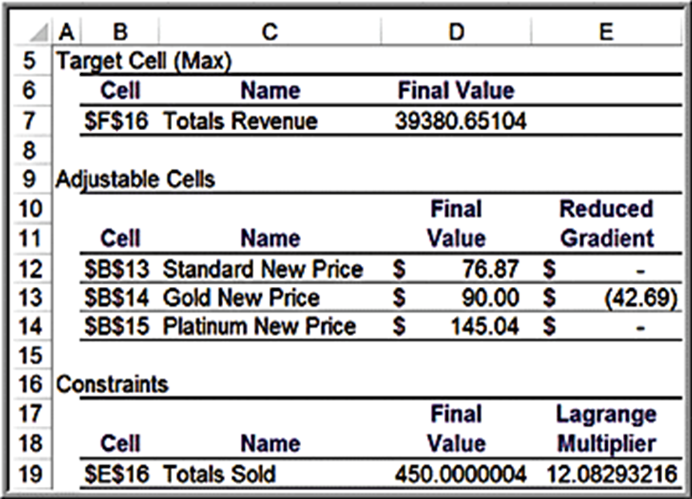
Example 15.7: Interpreting Solver Reports for the Hotel Pricing Model (2 of 2)
Sensitivity Report
The Reduced gradient is analogous to the reduced cost in linear models, but generally only an approximation.
Lagrange multipliers are similar to shadow prices but are only approximations.
If the number of rooms increased by 1, the approximate revenue increase would be $12.08 (the actual increase found by re-solving is $11.87).

Slide 22
Models with Bounded Variables
Solver handles simple lower bounds (e.g.,
) and
upper bounds (e.g.,
) quite differently from
ordinary constraints in the Sensitivity report.
Lower and upper bounds are treated in a manner similar to nonnegativity constraints, which also do not appear explicitly as constraints in the model.
This makes it more difficult to interpret the sensitivity information, because we no longer have the shadow prices and allowable increases and decreases associated with these constraints.

Slide 23
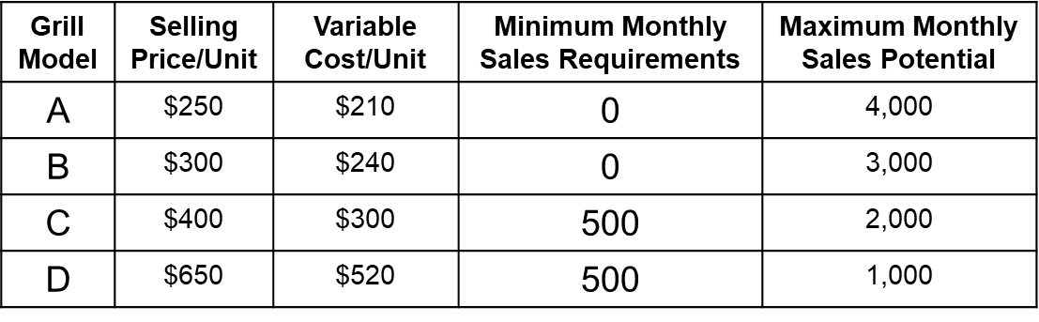
Example 15.8: J&M Manufacturing (1 of 3)
J&M Manufacturing makes 4 models of gas grills.
Determine how many grills to produce in order to maximize profit.
Department | A | B | C | D | Hours Available
Stamping | 40 | 30 | 10 | 10 | 320
Painting | Blank | 20 | 10 | 10 | 320
Assembly | 25 | 15 | 15 | 12 | 320
Inspection | 20 | 20 | 25 | 15 | 320
Packaging | 50 | 40 | 40 | 30 | 320

Slide 24
Example 15.8: J&M Manufacturing (2 of 3)
Model development
Define A, B, C, and D number of units of models A, B, C, and D to produce, respectively.
The objective function is to maximize the total net profit:
maximize
Constraints include limitations on the amount of production hours available in each department, the minimum sales requirements, and maximum sales potential limits.
Watch the dimensions carefully!

Slide 25
Example 15.8: J&M Manufacturing (3 of 3)
Constraints:
Department capacity
Minimum sales requirements and maximum sales potential

Slide 26
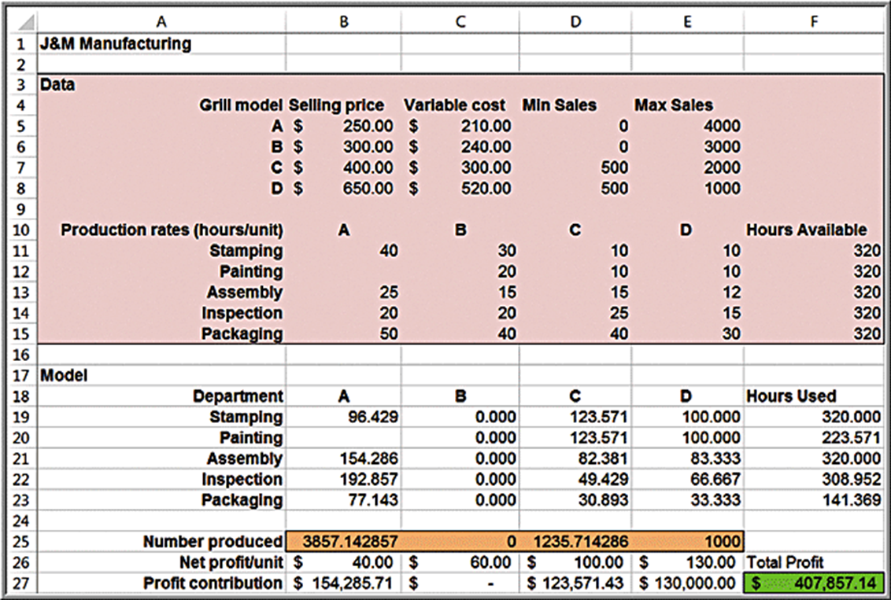
Spreadsheet Implementation for J&M Manufacturing

Slide 27
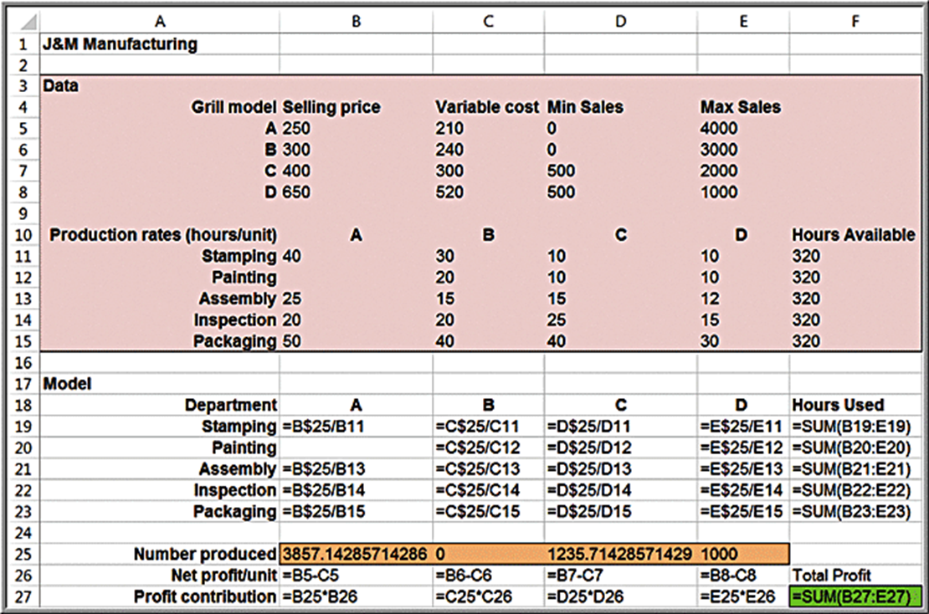
Spreadsheet Model Formulas for J&M Manufacturing

Slide 28

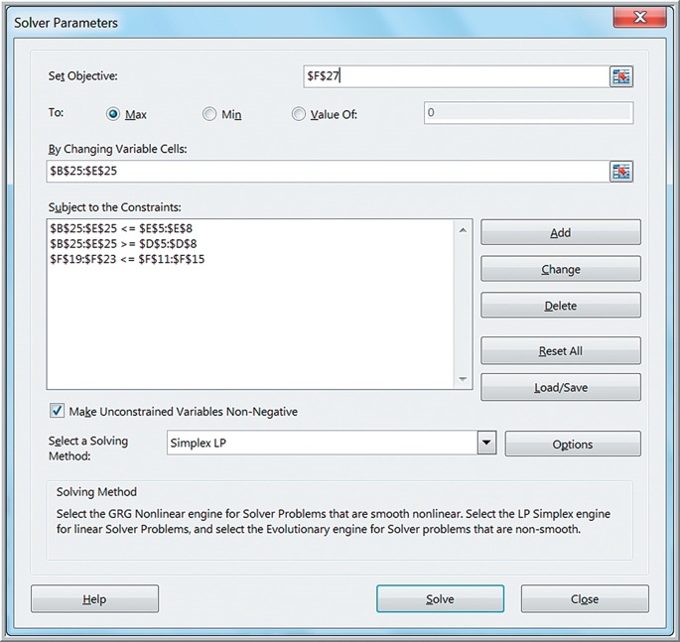
Solver Model for J&M Manufacturing

Slide 29
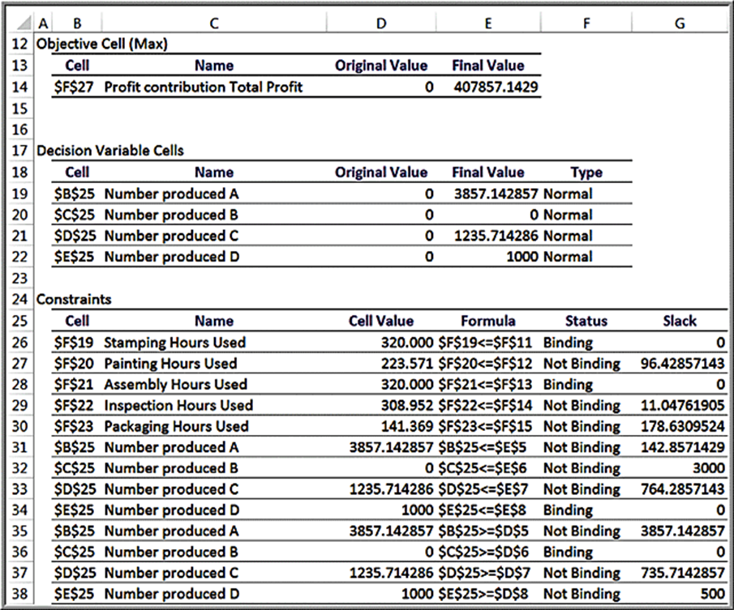
J&M Manufacturing Answer Report

Slide 30
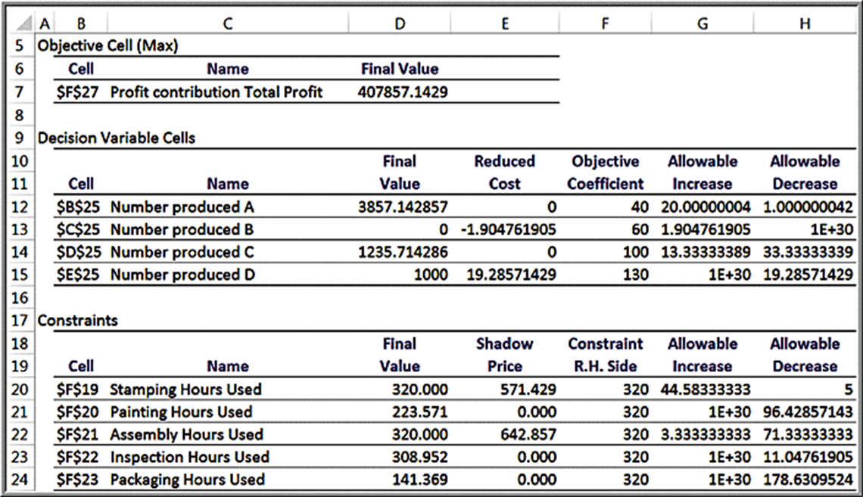
J&M Manufacturing Sensitivity Report
Note that none of the bound constraints appear in the Constraints section.

Slide 31
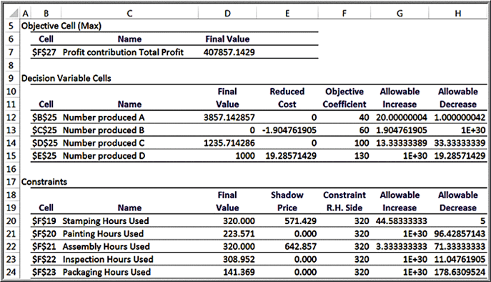
Interpreting Reduced Costs
For product B, the lower bound constraint is
How much more would the profit on B have to
be in order for it to be economical to produce anything other than the minimum amount required?
The answer is given by the reduced cost. The unit profit on B would have to be reduced by at least − $1.905 (that is, increased by at least + $1.905).
Product D is at its upper bound.
The reduced costs of $19.29 tells how much the unit profit has to be lowered before it is no longer economical to produce the maximum amount

Slide 32
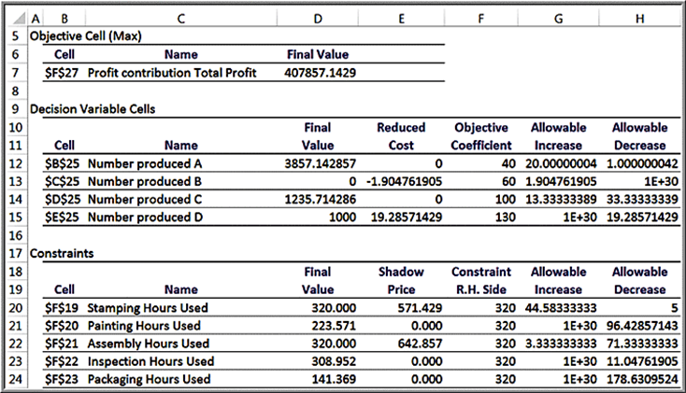
Interpreting Reduced Costs as Shadow Prices
Increasing the right-hand-side value of the bound constraint,
by 1 unit will result in a profit reduction of $1.905.
Increasing the right-hand side of the constraint
by 1 will
increase the profit by $19.29.
The reduced cost associated with a bounded variable is the same as the shadow price of the bound constraint. However, we no longer have the allowable range over which we can change the constraint values.

Slide 33
Auxiliary Variables for Bound Constraints
Auxiliary variables are a new set of cells for any decision variables that have upper- or lower-bound constraints created by referencing (not copying) the original changing cells.
In the Solver model, use auxiliary variable cells-not the changing variable cells as defined-to define the bound constraints.
Auxiliary variables allow easier interpretation of shadow prices for bounded variables.

Slide 34
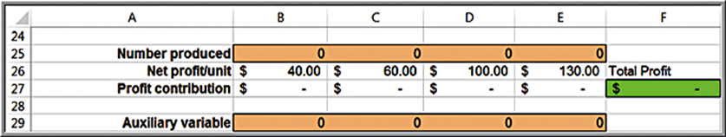
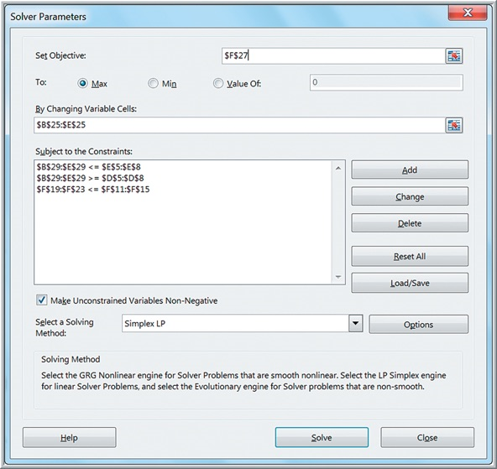
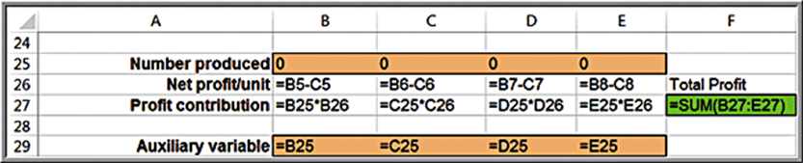
Example 15.9: Using Auxiliary Variable Cells (1 of 2)
J&M Manufacturing model

Slide 35
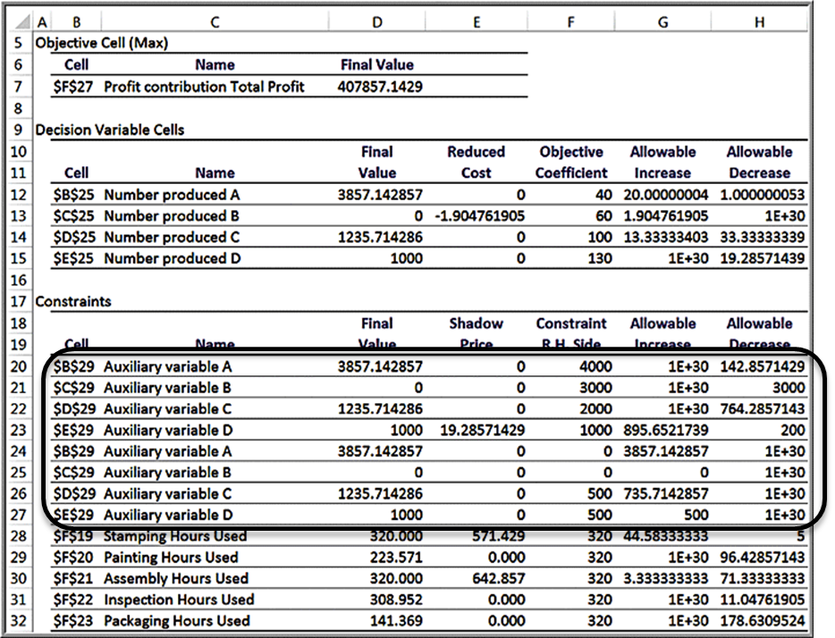
Example 15.9: Using Auxiliary Variable Cells (2 of 2)
Sensitivity report
Bound constraints now appear in the Constraints section.

Slide 36
What-If Analysis for Integer Optimization Models
Because integer models are discontinuous by their very nature, sensitivity information cannot be generated in the same manner as for linear models; therefore, no Sensitivity Report is provided by Solver -only the Answer Report is available.
To investigate changes in model parameters, it is necessary to re-solve the model.

Slide 37
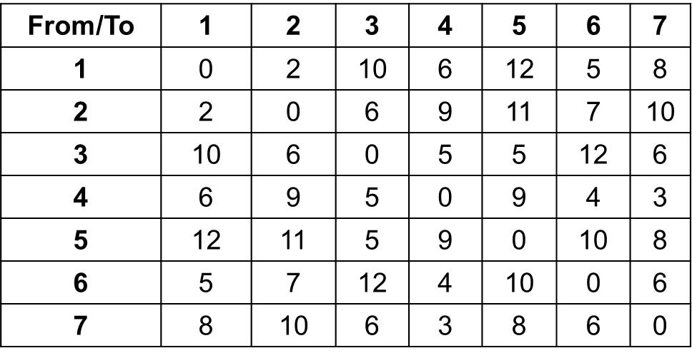
Example 15.10: Anderson Village Fire Stations (1 of 3)
“Covering problem”: find a subset of locations that cover a service area.
The Fire Department serves 7 districts.
The village wants to determine where to locate fire stations so that response times to residents in all 7 districts is no more than 8 minutes.
Response times:

Slide 38
Example 15.10: Anderson Village Fire Stations (2 of 3)
Model development
Define
as binary
if a fire station is located in district j
if a fire station is not located in district j
Minimize the number of fire stations:
Each district must be reachable within 8 minutes by some fire station:

Slide 39
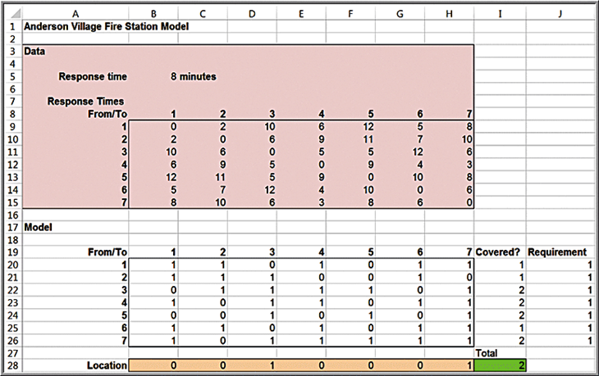
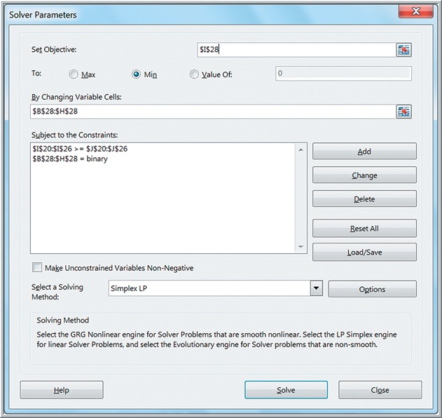
Example 15.10: Anderson Village Fire Stations (3 of 3)
Spreadsheet implementation and Solver model
Construct a matrix by converting all response times that are within 8 minutes to 1s and those that exceed 8 minutes to 0s. Then the constraint functions for each district are simply the SUMPRODUCT of the decision variables and the rows of this matrix

Slide 40
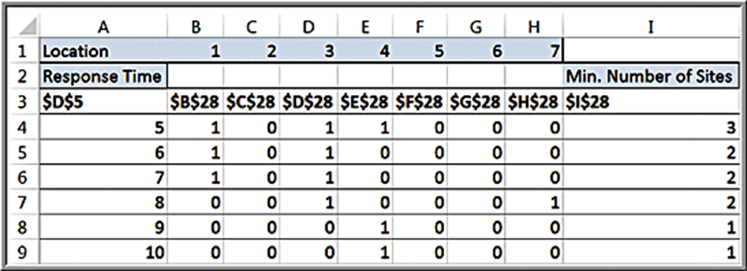
Example 15.11: What-If Analysis for Response Time
The village’s board of trustees wants to better understand the trade-offs between response time and required number of fire stations.
Vary response times from 5 to 10 minutes to see the effect on the number of fire stations required.
A response time of 5 minutes requires 3 fire stations.
A response time of 9-10 minutes requires 1 fire station.

Slide 41
Visualization of Solver Reports
Solver requires some technical knowledge of linear optimization concepts and terminology, such as reduced costs and shadow prices.
Data visualization can help analysts present optimization results in forms that are more understandable and can be easily explained to managers and clients in a report or presentation.

Slide 42
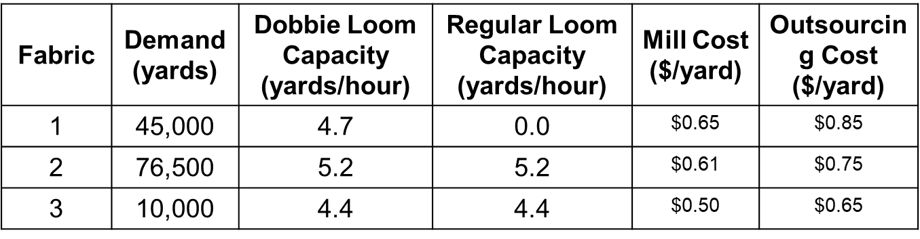
Example 15.12: Camm Textiles (1 of 5)
A mill that operates on a 24/7 basis produces three types of fabric on a make-to-order basis.
The key decision is which type of loom to use for each fabric type over the next 13 weeks.
The mill has 3 dobbie looms and 15 regular looms.
If demand cannot be met, the fabric is outsourced.

Slide 43
Example 15.12: Camm Textiles (2 of 5)
Model Formulation
= yards fabric i to produce on dobbie loom
= yards fabric i to produce on regular loom
= yards fabric i to outsource
Objective
Minimize total cost of milling and outsourcing
Constraints
Requirements: Total production and outsourcing of each fabric = demand
Limitations: Production on each type of loom cannot exceed the available production time
Nonnegativity

Slide 44
Example 15.12: Camm Textiles (3 of 5)
Demand constraints
Production + outsourcing = demand
Fabric 1:
Fabric 2:
Fabric 3:

Slide 45
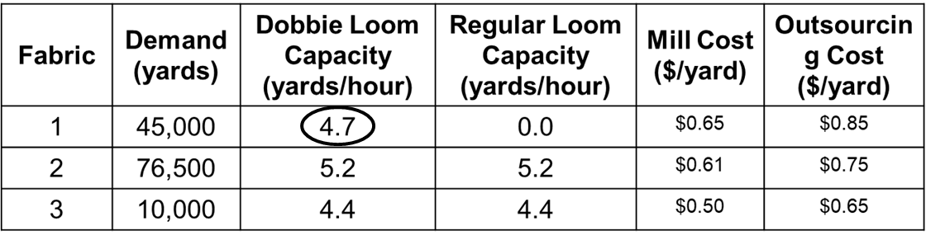
Example 15.12: Camm Textiles (4 of 5)
Loom capacity limitation constraints
First convert yards/hour into hours/yard.
E.g., for fabric 1 on the dobbie loom:
Capacity of the three dobbie looms:
Constraint on available production time on dobbie looms:
Constraint for regular looms:

Slide 46
Example 15.12: Camm Textiles (5 of 5)
Full Model
Fabric 1 demand:
Fabric 2 demand:
Fabric 3 demand:
Dobbie loom capacity:
Regular loom capacity:
Nonnegativity:

Slide 47
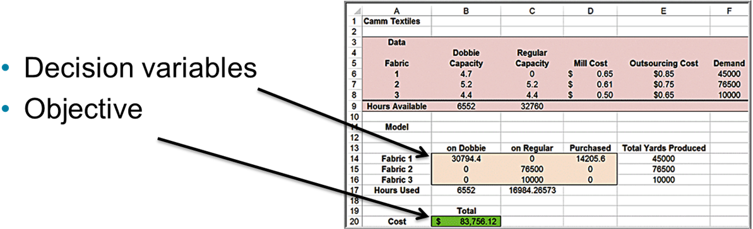
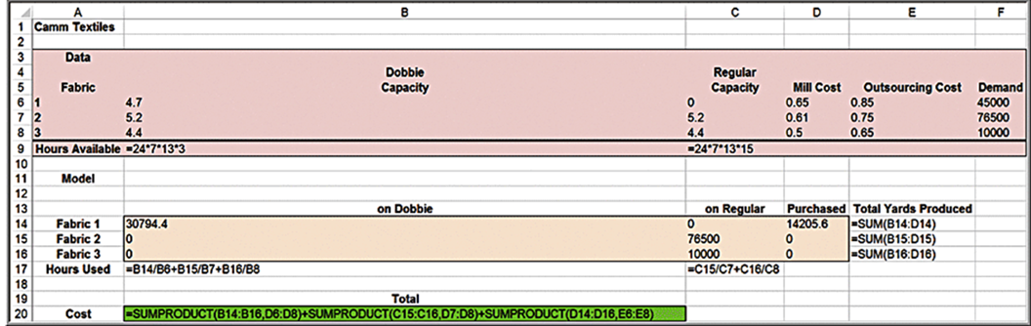
Spreadsheet Design
Camm Textiles model

Slide 48
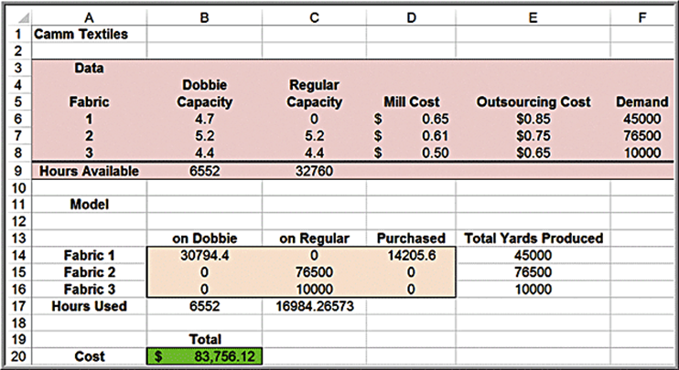
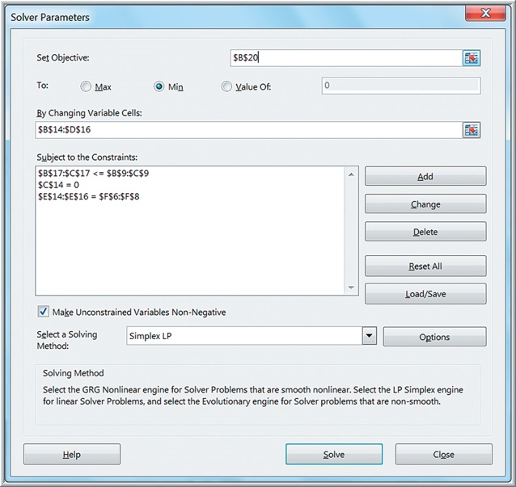
Solver Model
Set cell C14 to zero as a constraint because fabric 1 cannot be produced on a regular loom. Whenever you restrict a single decision variable to equal a value or
set it as a
type of constraint, Solver considers it as a simple bound.

Slide 49
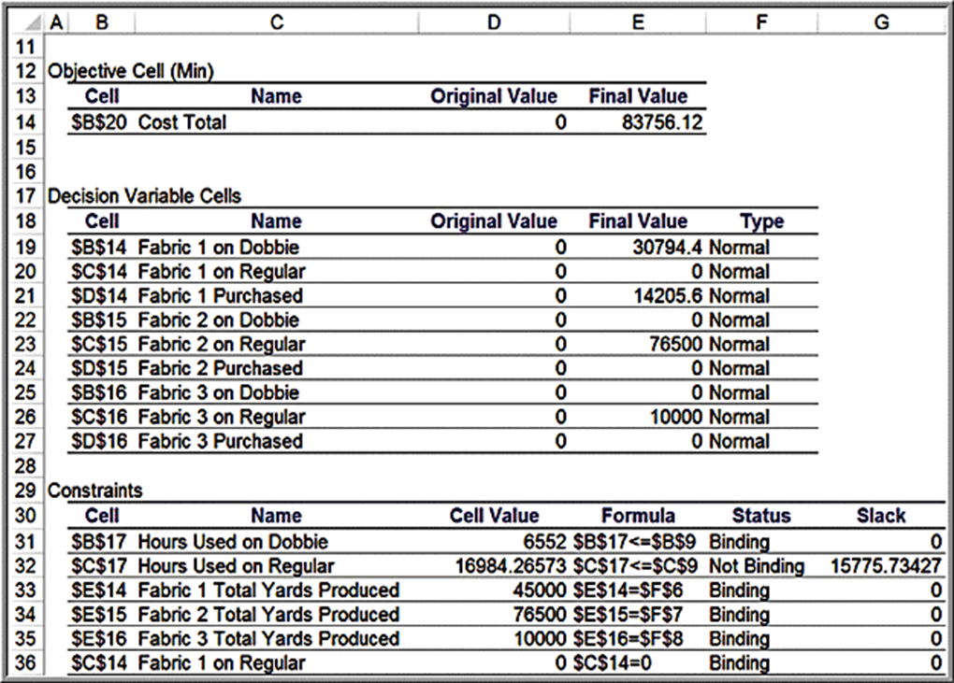
Camm Textiles Solver Answer Report

Slide 50
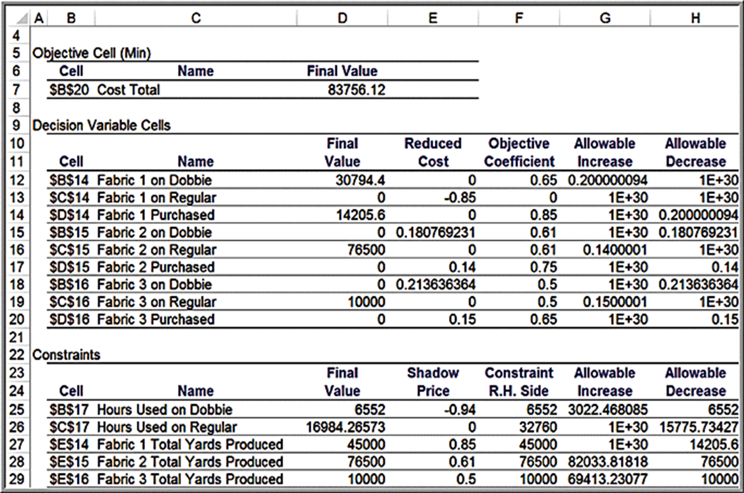
Camm Textiles Solver Sensitivity Report

Slide 51
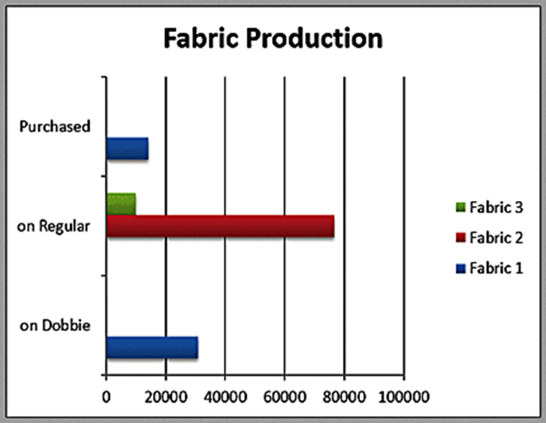
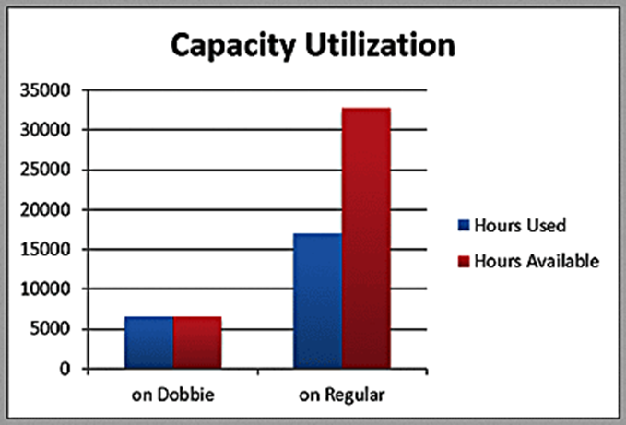
Answer Report Visualization

Slide 52
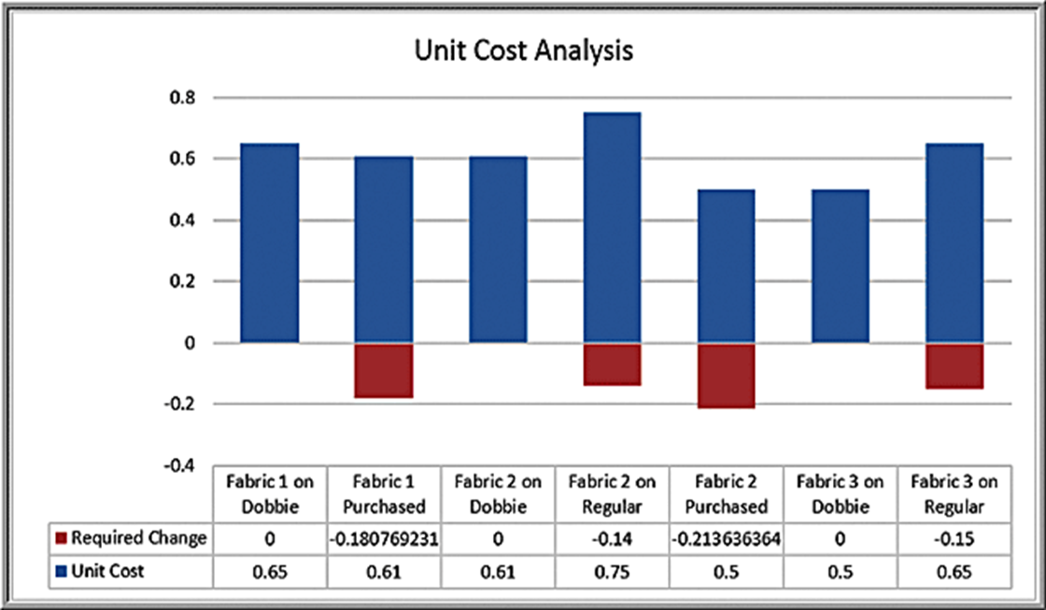
Reduced Cost Visualization

Slide 53
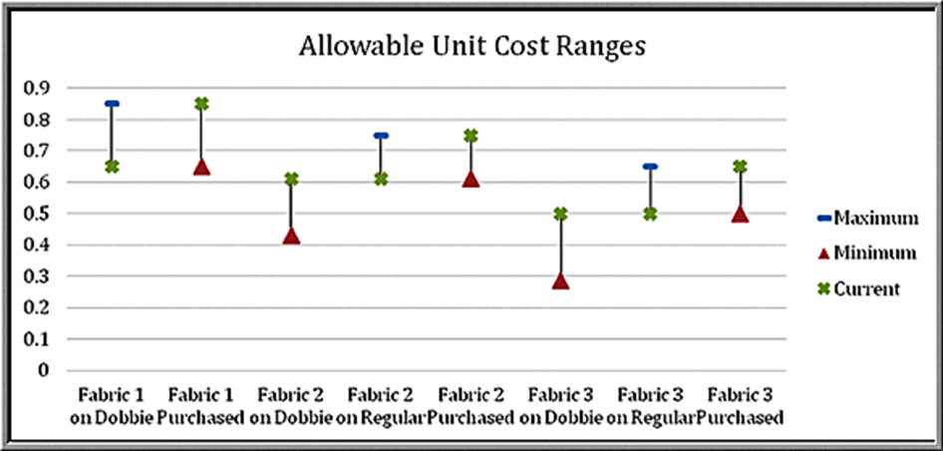
Visualizing Allowable Ranges
Unit cost coefficients: use an Excel Stock Chart (see text for details).
A stock chart typically shows the “high-low-close” values of daily stock prices; here we can compute the maximum-minimum-current values of the unit cost coefficients.
For those lines that have no maximum limit (the blue dash) such as with Fabric 1 Purchased, the unit costs can increase to infinity; for those that have no lower limit (the red triangle) such as Fabric 1 on Dobbie, the unit costs can decrease indefinitely.

Slide 54
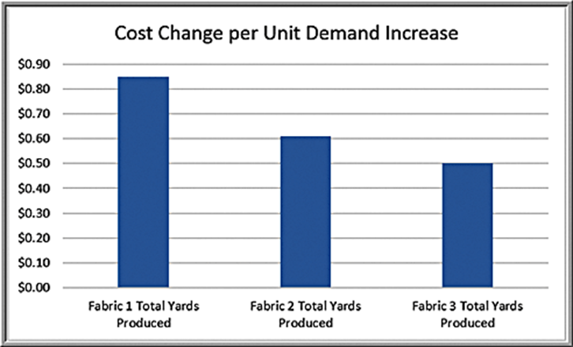
Visualizing Shadow Prices
Shadow prices show the impact of changing the right-hand side of a binding constraint. Because the plant operates on a 24/7 schedule, changes in loom capacity would require in “chunks” (i.e., purchasing an additional loom) rather than incrementally.
However, changes in the demand can easily be assessed using the shadow price information.

Slide 55
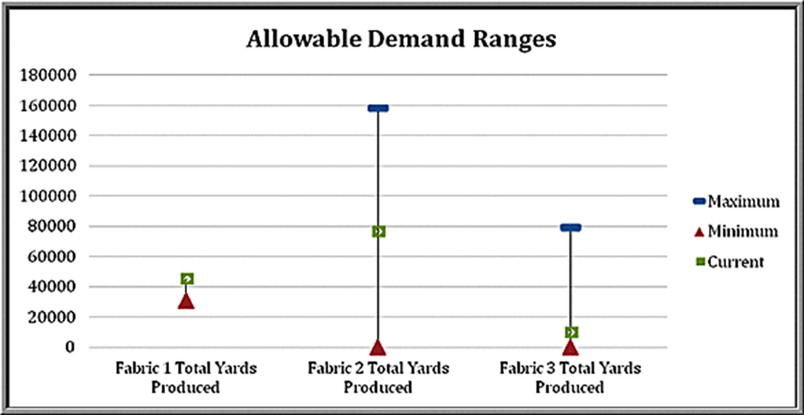
Visualizing Allowable Ranges for Shadow Prices
Stock Chart

Slide 56
Using Sensitivity Information Correctly
One crucial assumption in interpreting sensitivity analysis information for changes in model parameters is that all other model parameters are held constant.

Slide 57
Example 15.13: Walker Wines (1 of 3)
A production/marketing allocation problem
Walker Wines buys grapes from local growers and blends the pressings to make two types of wine (Shiraz and Merlot). Grape costs are $1.60 per bottle Shiraz and $1.40 per bottle Merlot.
Their contract requires between 40% and 70% of their wine to be Shiraz.
Predicted demand for Shiraz is 1000 bottles but increases by 5 bottles for each dollar spent on advertising; the base demand for merlot is 2,000 bottles and increases by 8 bottles for each $1 spent on advertising.
Production should not exceed demand.
Shiraz sells to retail stores for $6.25 per bottle and merlot is sold for $5.25 per bottle.
$50,000 is available to purchase grapes and advertise products.

Slide 58
Example 15.13: Walker Wines (2 of 3)
Model formulation
Define
S = number of bottles of Shiraz produced
M = number of bottles of merlot produced
= dollar amount spent on advertising Shiraz
= dollar amount spent on advertising merlot
Maximize profit

Slide 59
Example 15.13: Walker Wines (3 of 3)
Constraints
Do not exceed budget
Meet contractual requirements
or expressed in linear form:
Production must not exceed demand
Nonnegativity

Slide 60
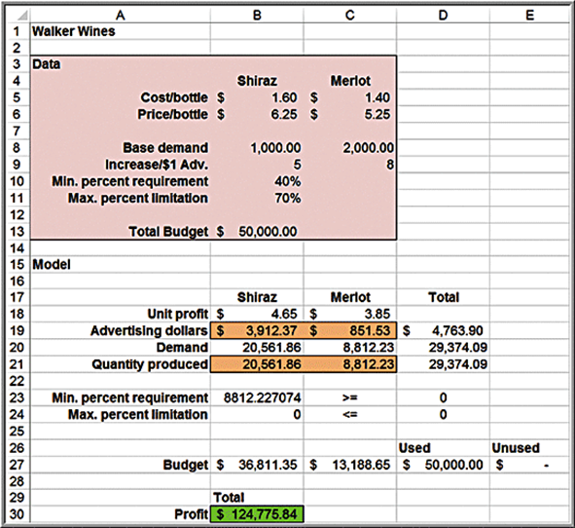
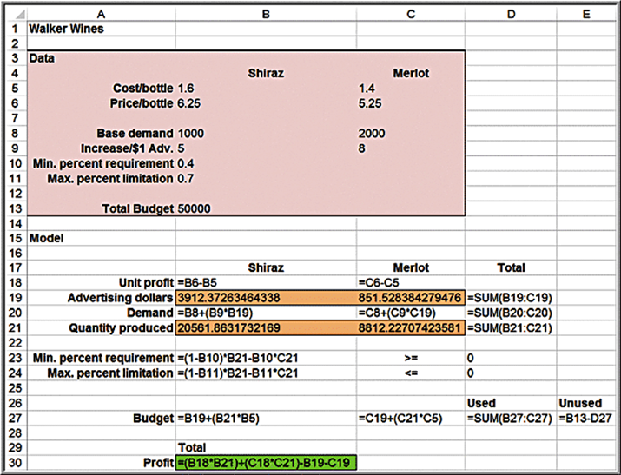
Spreadsheet Implementation for Walker Wines

Slide 61
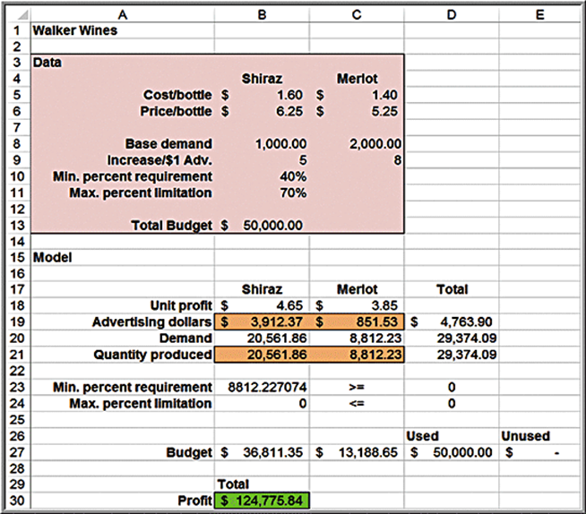
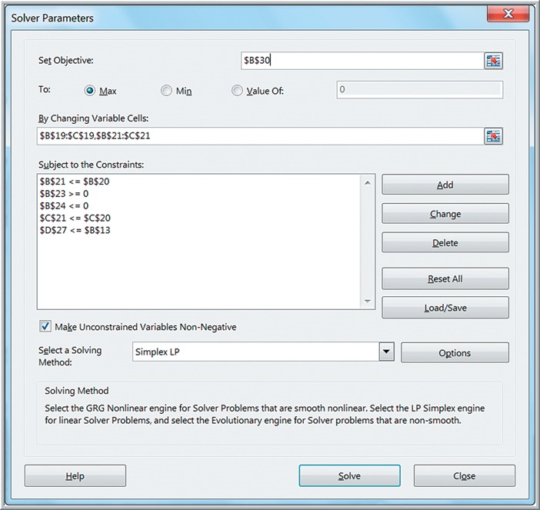
Solver Model for Walker Wines

Slide 62
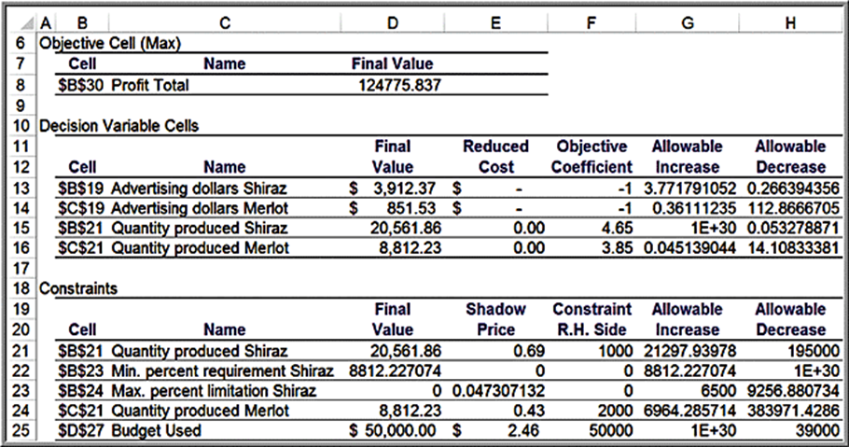
Example 15.14: Evaluating a Cost Increase for Walker Wines (1 of 2)
Suppose the cost of Shiraz grapes increase $0.05 per bottle.
A $0.05 increase in cost results in a drop in the unit profit of Shiraz from $4.65 to $4.60. In the Sensitivity report, however, the change in the profit coefficient is within the allowable decrease of 0.05328, thus concluding that no change in the optimal solution will result.

Slide 63
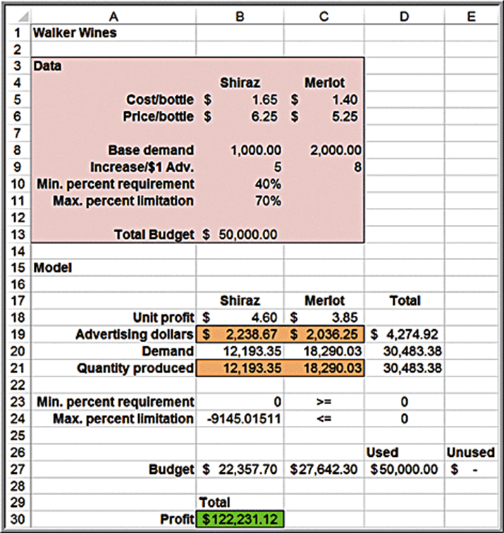
Example 15.14: Evaluating a Cost Increase for Walker Wines (2 of 2)
If the model is re-solved using the new cost parameter, the solution changes dramatically.
In this case, the unit cost is also reflected in the binding budget constraint. When we change the cost parameter, the constraint also changes. This violates the assumption that all other model parameters are held constant.

